Slide 1

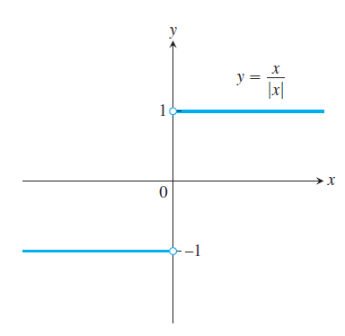
Section 2.4 One-Sided Limits
To have a limit L as x approaches c, a function ƒ must be defined on both sides of c and its values ƒ(x) must approach L as x approaches c from either side. Because of this, ordinary limits are called two-sided.

Slide 2



Slide 3
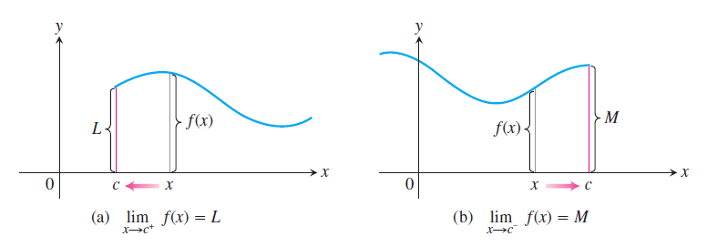
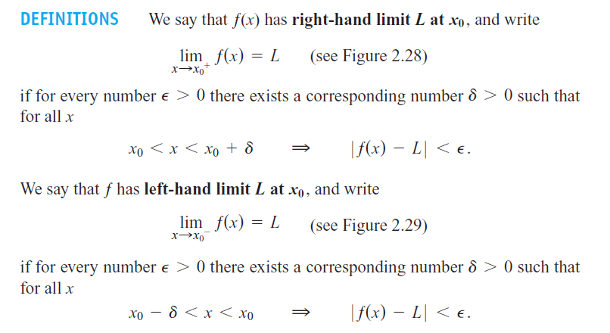

Slide 4

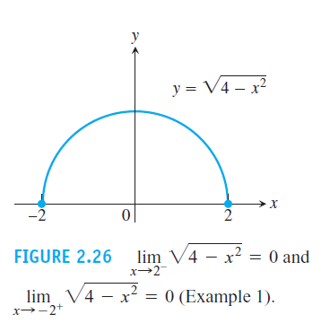

Slide 5
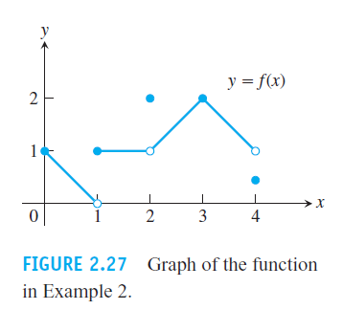
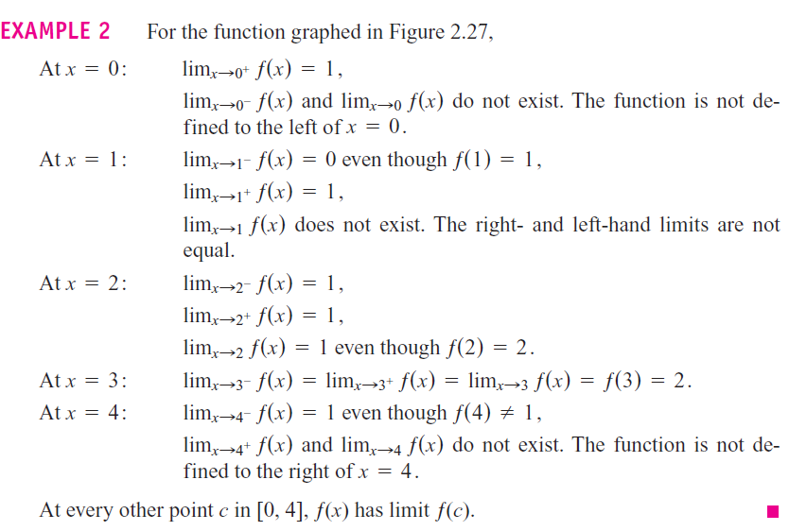

Slide 6
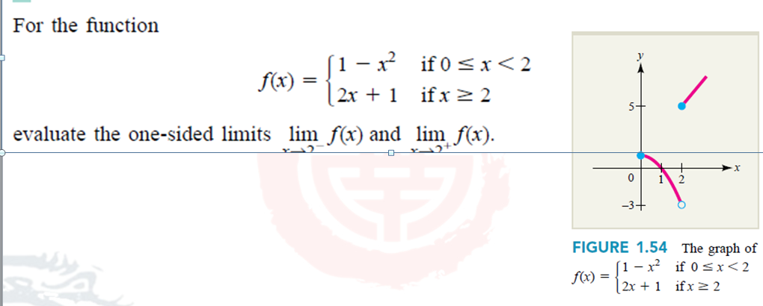
Example 4 :

Slide 7




Corollary: If , then doesn’t exist.

Slide 8


Example 5 : Given
Discuss the limit of as
Solution:
Since
Obviously
therefore
doesn’t exist .

Slide 9
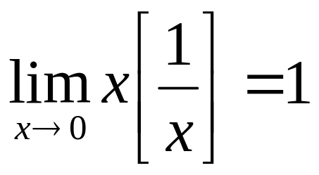
Example: Show that

Slide 10

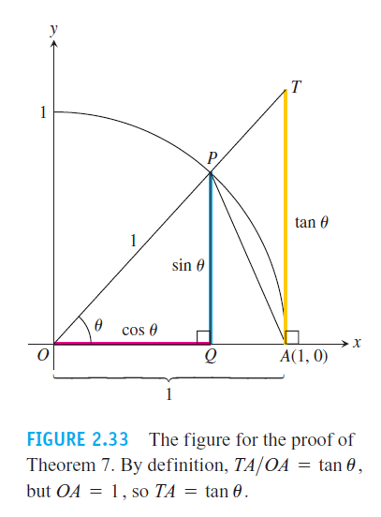

Slide 11


Example 6 :
Example 7 :

Slide 12
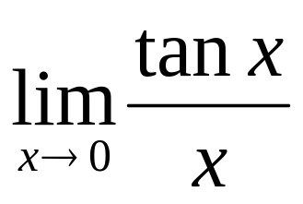
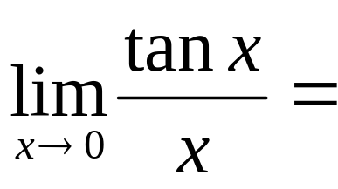
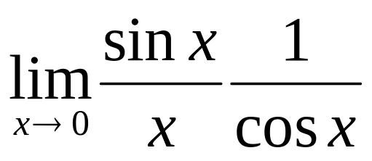
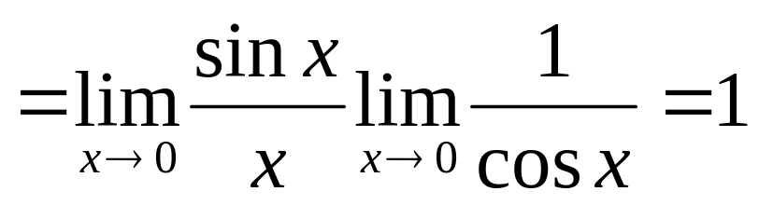
Example 8: Find
Solution:

Slide 13
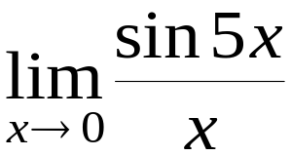
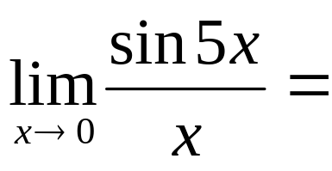
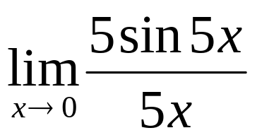
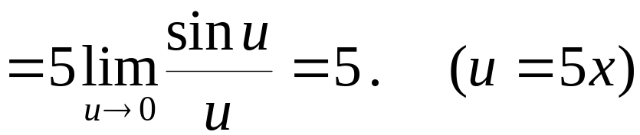
Example 9: Find
Solution:

Slide 14
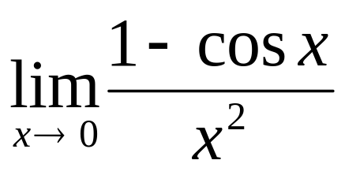
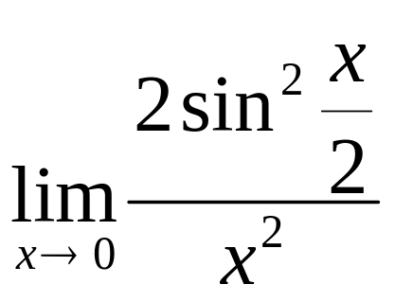
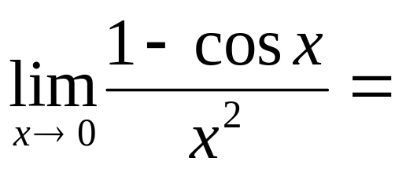
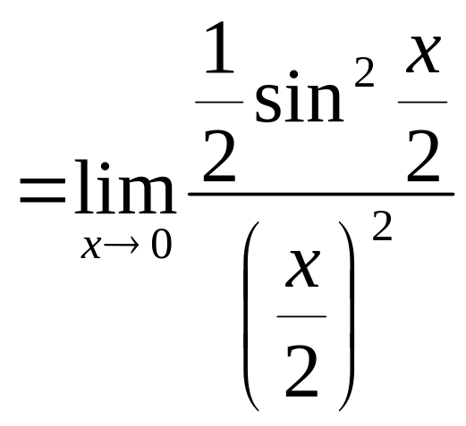
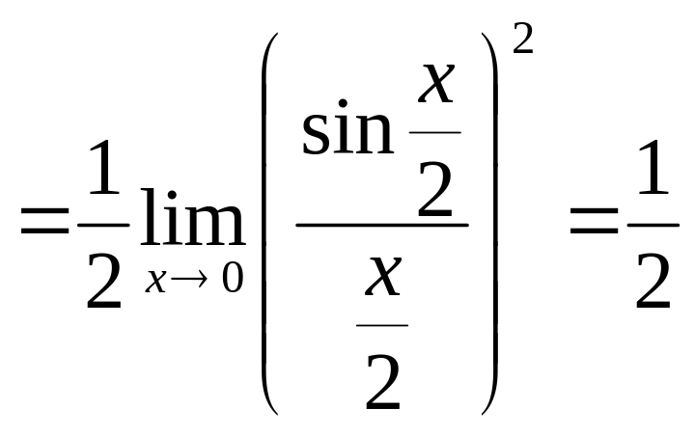
Example 10: Find
Solution:

Slide 15
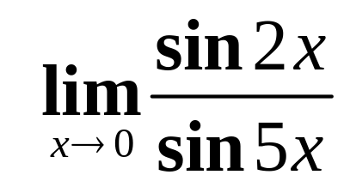
Example 11: Find

Slide 16
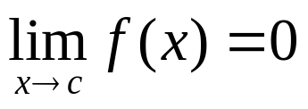
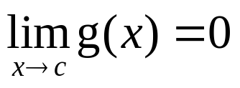
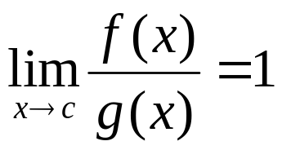
Definition: If ， then we call f(x) is an infinitesimal as x approaches c.
Definition: If ， and
then we call f(x) and g(x) are equivalent infinitesimals as x approaches c, and we denote it by f(x)~g(x) (x→c)

Slide 17
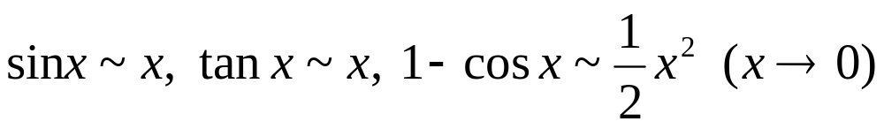
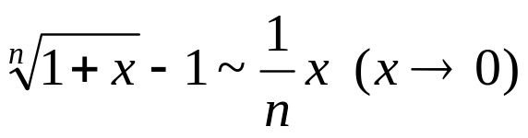
Example:
Example: Show that

Slide 18
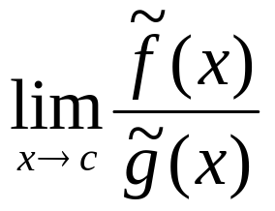

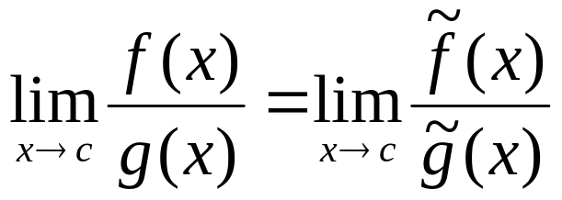
Theorem: If and
exists, then
Remark: The equivalent infinitesimal is applied only for the quotient and product, it is not applied for the sum and difference, Be careful!

Slide 19
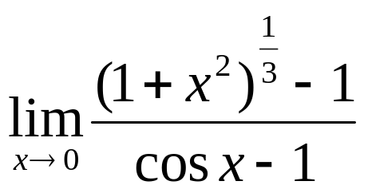
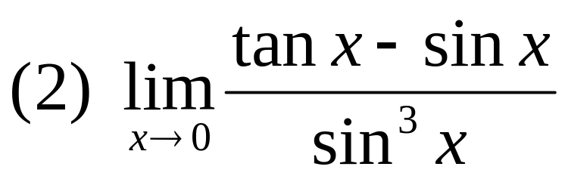
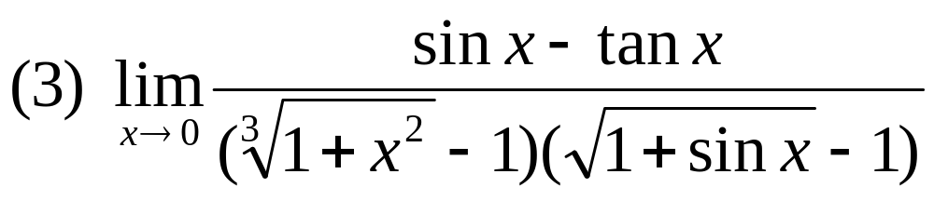
Example: Find (1)

Slide 20
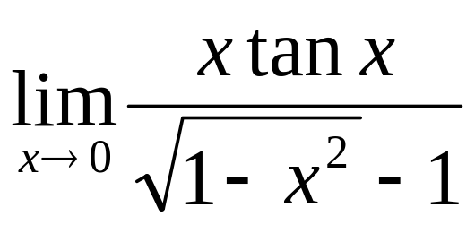
Homework 1: Find
Homework2: Page 90: 12, 15, 29, 30

